Slide 1
Agenda and Logistics 70-535 Architecting Azure Solutions
Room: 1st Floor – Washington/Jefferson
WiFi: MSFTGUEST; Open browser; Event Code: TBD
Content: https://github.com/guruskill/70-535 …
Folders Decks: Presentations\2018-05-14-Boston\ Labs: Labs\
Program Home: https://aka.ms/certup
Microsoft Office - 5 Wayside Rd, Burlington, MA
1st Floor – Washington/Jefferson
Day 1: Monday, May 14, 2018
Day 2: Tuesday, May 15, 2018
Time | Topic | Speaker
8:30 – 9:00 | Breakfast, registration, setup
8:45 – 9:00 | Welcome | Ryan Sockalosky
8:45 – 9:00 | Agenda Overview | Dan Stolts
9:15 – 10:15 | Becoming a Cloud Architect & DevOps | Dan
10:15 – 10:30 | Break & Networking with Microsoft
10:30 – 11:30 | Design Data Implementation | Patrick
11:30 – 12:30 | Design Network Implementation | Coach
12:30 – 1:30 | Lunch & Networking & Labs
1:30 – 2:45 | Design Compute Infrastructure | Dan
2:45 – 3:00 | Break & Networking with Microsoft
3:00 – 3:45 | Design Security & Identity Solutions | Coach
3:45 – 5:00 | Making it Real with Practical Application – Brainstorming & Labs | Dan, Coach, Patrick, Others
Time | Topic | Speaker
8:30 – 9:00 | Breakfast, registration, setup
9:00 – 10:15 | Exam Tips and Architecting for your company | Dan
10:15 – 10:30 | Break & Networking with Microsoft
10:30 – 12:00 | Design Solutions using Platform Services, Part 1 | Coach
12:00 – 1:00 | Lunch & Networking & Labs
1:00 – 2:00 | Design Solutions using Platform Services, Part 2 | Coach
2:00 – 3:15 | Design for Operations | Patrick
3:15 – 3:30 | Break
3:30 – 4:15 | Making it Real: Whiteboarding | All
4:15 – 4:45 | Making it Real: Architecting Real World Solutions – Whiteboarding | All
4:45-5:00 | Wrap-Up/Closing Next Steps and Homework (Labs)
Evaluation Link: https://tinyurl.com/510GA535

Slide 2
Exam 70-535 Architecting Microsoft Azure Solutions Data & Cloud Skill Up Workshop - Azure Fundamentals
Design Compute Infrastructure (20-25%)
Design Data Implementation (15-20%)
Design Networking Implementation (15-20%)
Design Security and Identity Solutions (20-25%)
Design Solutions by using Platform Services (10-15%)
Design for Operations (10-15%)

Slide 3
Create and Manage Compute Resources (20-25%)
Deploy workloads on Azure Resource Manager (ARM) virtual machines (VMs)
Perform configuration management
Design and implement VM storage
Monitor ARM VMs
Manage ARM VM availability
Scale ARM VMs
Manage Containers with Azure Container Services (ACS)
Dan Stolts
Chief Technology Strategist, Microsoft
Blog: ITProGuru.com
LinkedIn: danstolts
Twitter: @ITProGuru
itproguru@microsoft.com
https://www.microsoft.com/en-us/learning/exam-70-535.aspx
March 22, 2018 changes: http://download.microsoft.com/download/6/A/5/6A5A0096-1E8A-425D-9C6A-CE28EE4708A5/535_OD_Changes.pdf

Slide 4
Create and Manage Compute Resources (20-25%)
Design solutions using virtual machines (VMs)
Design VM deployments by leveraging availability sets, fault domains, and update domains in Azure; use web app for containers; design VM Scale Sets; design for compute-intensive tasks using Azure Batch and Azure Batch AI; define a migration strategy from cloud services; determine when to use reserved instances; design for VMs in a DevTest Lab environment (including formulas, images, artifacts, claiming and un-claiming VMs); determine when to use Accelerated Networking; recommend use of Azure Backup and Azure Site Recovery including support for Linux in Azure Backup and integrating Azure Backup in the VM creation process; recommend when to use availability zones
Design solutions for serverless computing
Use Azure Functions to implement event-driven actions; design data storage solutions for serverless computing; design for serverless computing using Azure Container Instances; design application solutions by using Azure Logic Apps, Azure Functions, or both; determine when to use API management service; design event routing solutions using Azure Event Grid; design solutions that integrate stream processing and bot messaging
Design microservices-based solutions
Design Azure App Service Web Apps; design custom web API; secure Web API; design Web Apps for scalability and performance; design for high availability using Azure Web Apps in multiple regions; determine which App service plan to use; design Web Apps for business continuity; determine when to use Azure App Service Isolated; design for API apps; determine when to use API management service; determine when to use Web Apps on Linux; determine when to use a CDN; determine when to use a cache, including Azure Redis cache
Design web applications
Design Azure App Service Web Apps; design custom web API; secure Web API; design Web Apps for scalability and performance; design for high availability using Azure Web Apps in multiple regions; determine which App service plan to use; design Web Apps for business continuity; determine when to use Azure App Service Isolated; design for API apps; determine when to use API management service; determine when to use Web Apps on Linux; determine when to use a CDN; determine when to use a cache, including Azure Redis cache
Create compute-intensive applications
Design high-performance computing (HPC) and other compute-intensive applications using Azure Services; determine when to use Azure Batch; design stateless components to accommodate scale; design lifecycle strategy for Azure Batch; design solution that implement low priority batching and job task counting
March 22, 2018 changes: http://download.microsoft.com/download/6/A/5/6A5A0096-1E8A-425D-9C6A-CE28EE4708A5/535_OD_Changes.pdf

Slide 5
Deploy workloads on Azure Resource Manager (ARM) virtual machines (VMs)
Design VM deployments by leveraging availability sets, fault domains, and update domains in Azure; use web app for containers; design VM Scale Sets; design for compute-intensive tasks using Azure Batch and Azure Batch AI; define a migration strategy from cloud services; determine when to use reserved instances; design for VMs in a DevTest Lab environment (including formulas, images, artifacts, claiming and un-claiming VMs); determine when to use Accelerated Networking; recommend use of Azure Backup and Azure Site Recovery including support for Linux in Azure Backup and integrating Azure Backup in the VM creation process; recommend when to use availability zones

Slide 6
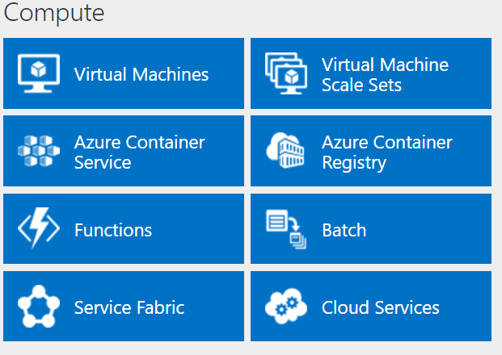
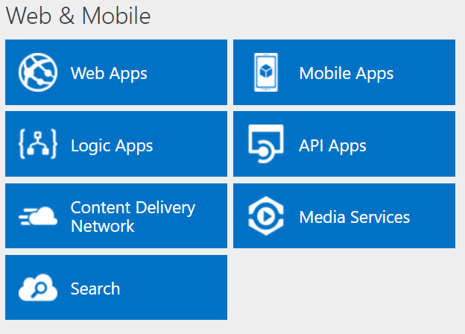
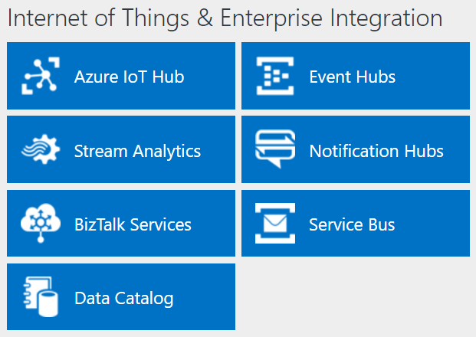
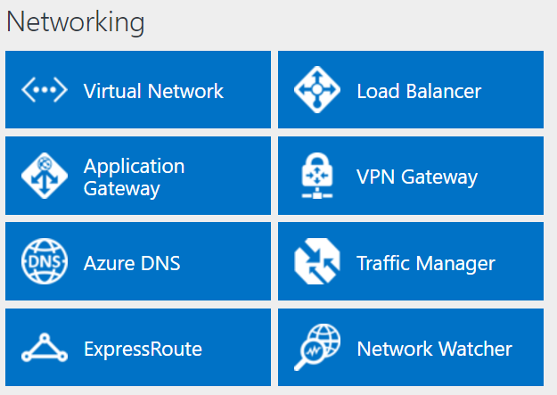
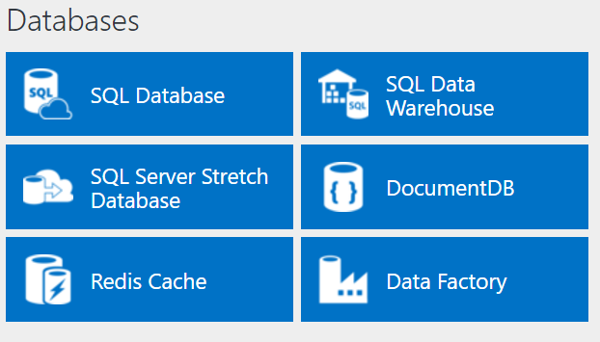
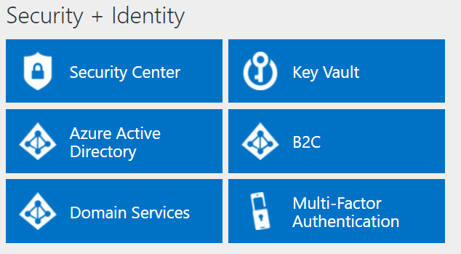
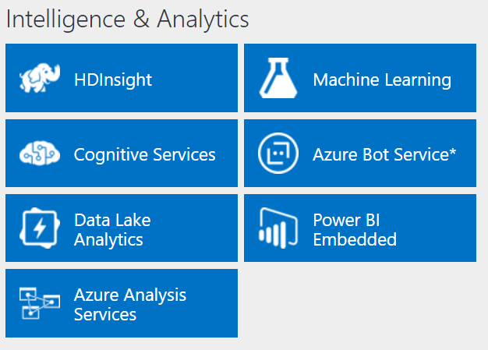
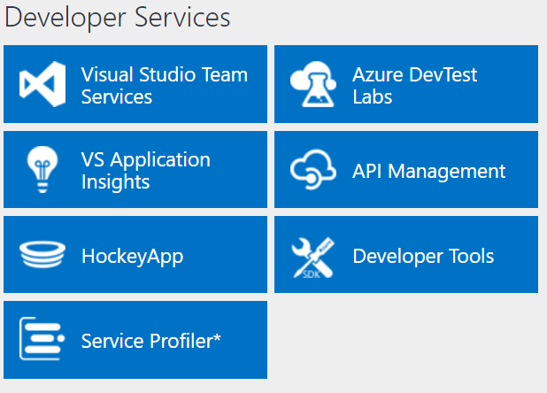
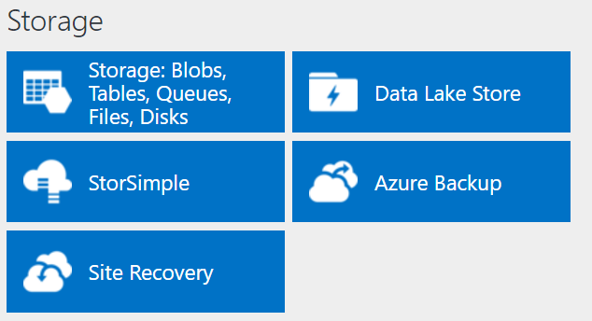
Azure Platform
http://azureplatform.azurewebsites.net/
* Preview Services
Notes:
Preview Version 1.7 (2017-04-20)

Slide 7
Azure Resource Manager (ARM)
All services offered as ARM resources
Consistent model for creating/managing Azure resources
Based on declarative templates
Resources are managed in resource groups
Deployed together
Managed together
Provides RBAC support
Notes:
Demo: Resource Explorer

Slide 8
Azure Resource Manager Terminology
Resource
A manageable unit of Azure infrastructure
Examples: virtual machine, load balancer, storage account
Resource provider
A service that allows for creation and management of resources
Examples: Compute Resource Provider, Storage Resource Provider
Resource manager template
A declarative template for describing a resource group

Slide 9
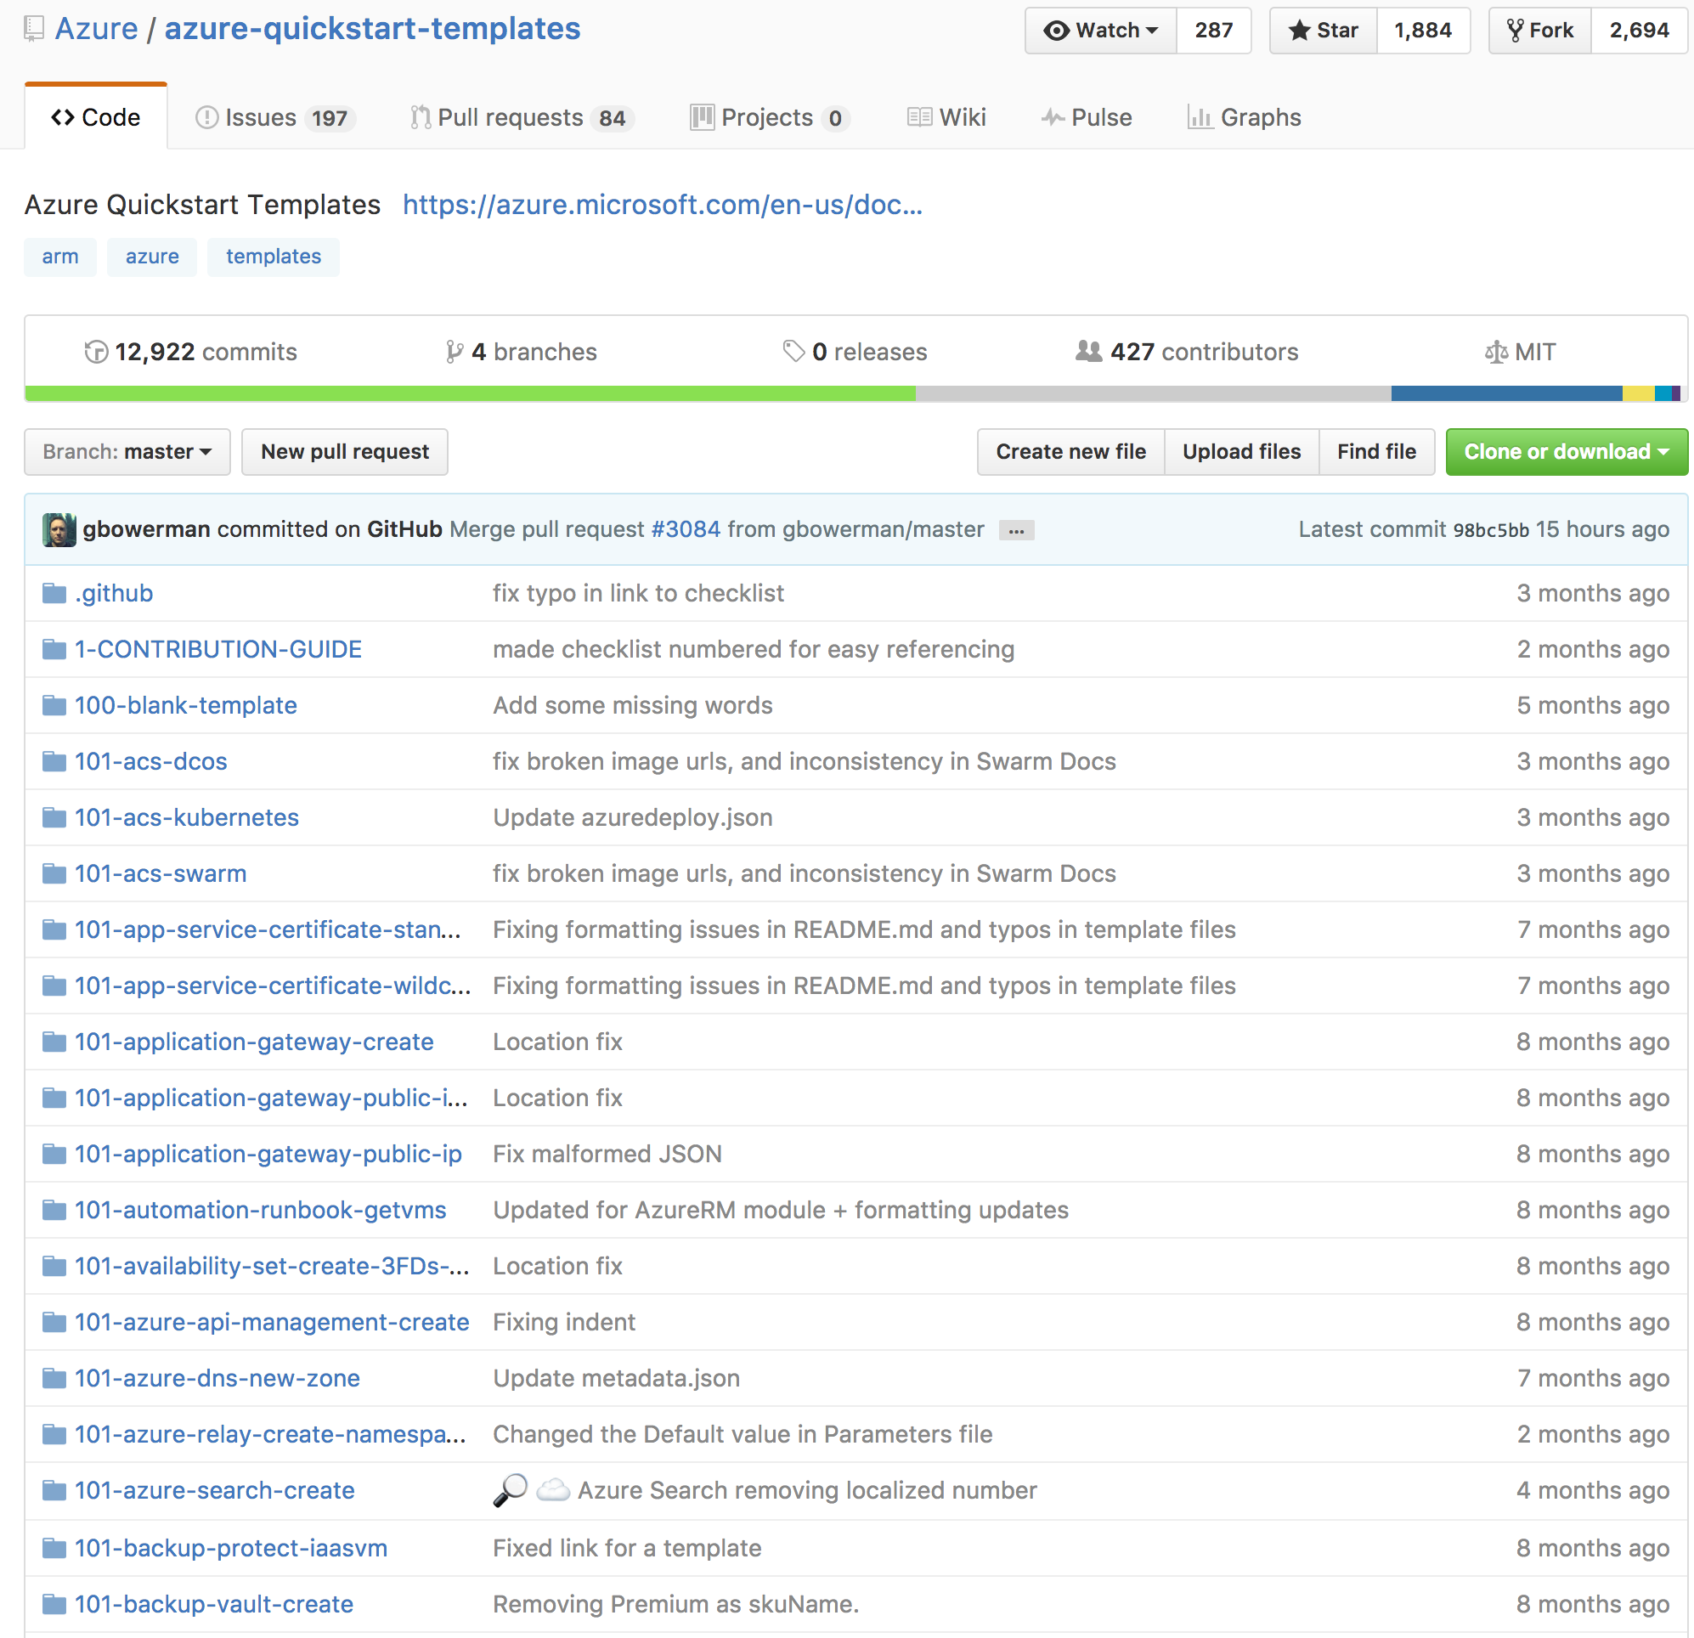
Reusable ARM templates
A declarative template for describing a resource group
Community offered or Build your own
Learn about template here:
https://azure.microsoft.com/en-us/resources/templates/
Notes:
Demo Azure getting started templates

Slide 10
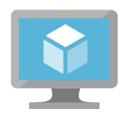
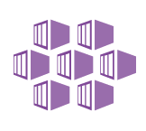
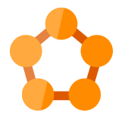
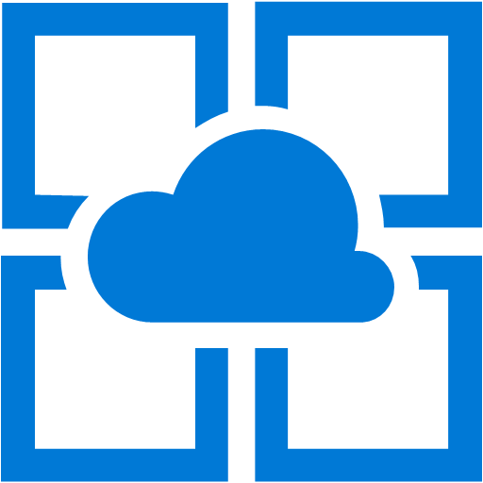

Azure: The Power Of Choice
Compute
Virtual Machines
Container Service
Service Fabric
App Service
Functions
More Control
Focus on the App
Customer-managed
(IaaS)
Platform-managed
(PaaS)
Code-only
(serverless)
Notes:
Azure provides several cloud-based compute offerings to run your application so that you don't have to worry about the infrastructure details.
You can easily scale up or scale out your resources as your application usage grows. Azure offers services that cover the spectrum—from providing infrastructure-as-a-service (IaaS) to give you full control over your application hosting, through platform-as-a-service (PaaS) where the services are hosted for you, to true serverless hosting where all you need to do is write your code.

Slide 11
Compute
IaaS VMs
VM Scale Sets
Batch
Logic Apps
Functions
App Service
Azure Container Service
Azure Container Instances
Service Fabric
Cloud Services
SERVERS!
SERVERLESS!
Computer Comparisonhttps://aka.ms/comparecompute

Slide 12
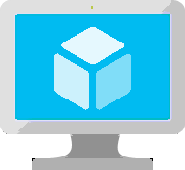
Virtual Machines
Ubuntu, Red Hat, Windows, SUSE, CoreOS
DevOps Extensions with Chef and Puppet
Multiple sizes
Hundreds of items in marketplace
Notes:
Really the basic building block of all other compute services
Valuable for cases where you’re simply lifting-and-shifting an existing workload to the cloud and want to maintain the existing topology.
Huge variety of OS images available, including all the popular Linux distros
Support for many popular configuration tools, including Chef and Puppet.
Available in many different sizes to fit your workload, including the recently announced N-series which offer Nvidia GPUs for graphically intense workloads.
And of course, since VMs make up the basic building blocks in our Compute story, many people have built interesting things out of them, which are available in the marketplace…

Slide 13

Azure VM Sizes
A
D
Dv2
G
Av2
Lowest Price
SSD Storage Fast CPUs
New generation of D family VMs
High memory and
Large SSDs
New A-Series
F
NC
NV
H
L
SAP
Compute Intensive
NVIDIA GPUs
K80 Compute
NVIDIA GPUs
M60 Visualization
Fastest CPU
IB Connectivity
Large SSDs
SAP Large Instances
Mar
Mar
Mar
Mar
ND
NCv2
Dv3
Ev3
Deep Learning
NVIDIA P40s
New gen of NC
NVIDIA P100s
New generation of D family
High memory
https://docs.microsoft.com/en-us/azure/virtual-machines/windows/sizes-gpu
Notes:
https://docs.microsoft.com/en-us/azure/virtual-machines/windows/sizes-gpu
Tiers – Define a set of capabilities that all VM sizes within the tier provide
Standard Tier - Offers the most flexibility. Supports all virtual machine configurations and features.
Basic Tier - An economical option for development workloads, test servers, and other applications that don't require load balancing, auto-scaling, or memory-intensive virtual machines.
Series – Define a set of capabilities based on the underlying host hardware the virtual machines run on
A Series – The first series of Azure IaaS virtual machines
D Series – Feature solid state drives (SSDs) and faster processors than the A-series and are also available for web or worker roles in Azure Cloud Services. This series is ideal for applications that demand faster CPUs, better local disk performance, or higher memories.
Size – Define a combination of CPU, RAM, and Disk
Example size: A2 - 2 CPU, 3.50 GB RAM, 135.00 GB Disk

Slide 14
VM Sizes
Type | Sizes | Description
General purpose | B (Preview), Dsv3, Dv3, DSv2, Dv2, DS, D, Av2, A0-7 | Balanced CPU-to-memory ratio. Ideal for testing and development, small to medium databases, and low to medium traffic web servers.
Compute optimized | Fs, F | High CPU-to-memory ratio. Good for medium traffic web servers, network appliances, batch processes, and application servers.
Memory optimized | Esv3, Ev3, M, GS, G, DSv2, DS, Dv2, D | High memory-to-CPU ratio. Great for relational database servers, medium to large caches, and in-memory analytics.
Storage optimized | Ls | High disk throughput and IO. Ideal for Big Data, SQL, and NoSQL databases.
GPU | NV, NC | Specialized virtual machines targeted for heavy graphic rendering and video editing. Available with single or multiple GPUs.
High performance compute | H, A8-11 | Our fastest and most powerful CPU virtual machines with optional high-throughput network interfaces (RDMA).
https://buildazure.com/2017/09/11/more-affordable-azure-vms-with-burstable-b-series/
Notes:
B series - https://buildazure.com/2017/09/11/more-affordable-azure-vms-with-burstable-b-series/
Determine Cores, RAM, ACUs, Disks, NICs, Network Speed, Temporary Storage, SSD support
High level categories:
Acu helps normalize cpu perf.. D&f have same acu

Slide 15
VM Azure Compute Unit (ACU)
SKU Family | ACU \ vCPU
A0 | 50
A1-A4 | 100
A5-A7 | 100
A1_v2-A8_v2 | 100
A2m_v2-A8m_v2 | 100
A8-A11 | 225*
D1-D14 | 160
D1_v2-D15_v2 | 210 - 250*
DS1-DS14 | 160
DS1_v2-DS15_v2 | 210-250*
D_v3 | 160-190* **
Ds_v3 | 160-190* **
E_v3 | 160-190* **
Es_v3 | 160-190* **
F1-F16 | 210-250*
F1s-F16s | 210-250*
G1-G5 | 180 - 240*
GS1-GS5 | 180 - 240*
H | 290 - 300*
L4s-L32s | 180 - 240*
M | 160-180**
Provide a way of comparing compute (CPU) performance across Azure SKUs
Not all Azure Cores are created equal
A1 Core != F1 Core
Compare compute (CPU) performance across SKUs.
https://docs.microsoft.com/en-us/azure/virtual-machines/windows/acu
Notes:
Not all Azure Cores are created equal
A1 Core != F1 Core
Compare compute (CPU) performance across SKUs.
https://docs.microsoft.com/en-us/azure/virtual-machines/windows/acu
Azure Compute Unit (ACU) to provide a way of comparing compute (CPU) performance across Azure SKUs. This will help you easily identify which SKU is most likely to satisfy your performance needs. ACU is currently standardized on a Small (Standard_A1) VM being 100 and all other SKUs then represent approximately how much faster that SKU can run a standard benchmark.
ACUs marked with a * use Intel® Turbo technology to increase CPU frequency and provide a performance boost. The amount of the boost can vary based on the VM size, workload, and other workloads running on the same host.+
**Hyper-threaded.

Slide 16
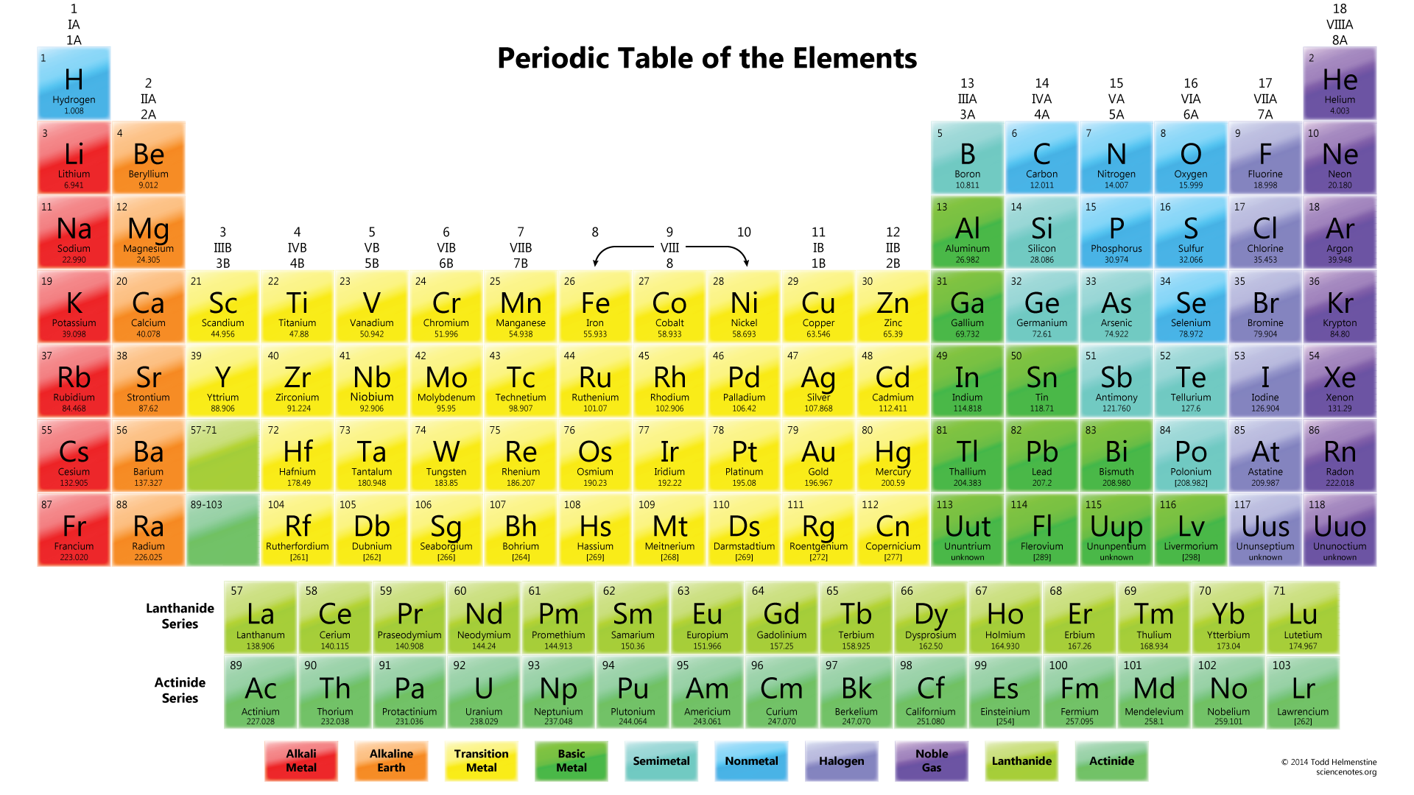
The Fundamental Element of Azure

Slide 17
The Fundamental Element of Azure
St
1
Storage
Notes:
Flexibility at multiple levels -
Access level – hot storage or cold storage
Tier
Abstraction level – files, disks
Disk level – spindle, SSD, managed
Redundancy level – LRS, ZRS, GRS, RAGRS

Slide 18
VM Disks
OS Disk (attached via SATA)
VHD based
Persists
Separate storage cost
Temporary Disk
Doesn’t persist - SSD
No Separate storage cost
Data Disk (SCSI)
VHD based
Persists
Separate storage cost
Current Max Data Disk Size: 4095GB
https://docs.microsoft.com/en-us/azure/storage/storage-premium-storage#scalability-and-performance-targets
Notes:
https://docs.microsoft.com/en-us/azure/storage/storage-premium-storage#scalability-and-performance-targets
The temporary disk is labeled as the D: drive by default and it used for storing pagefile.sys

Slide 19
Premium vs Standard (SSD vs HDD) Comparison
 | Azure Premium Disk | Azure Standard Disk
Disk Type | Solid State Drives (SSD) | Hard Disk Drives (HDD)
Overview | SSD-based high-performance, low-latency disk support for VMs running IO-intensive workloads | HDD-based cost effective disk support for Dev/Test VM scenarios
Scenario | Production and performance sensitive workloads | Dev/Test, non-critical, Infrequent access
Disk Size | P4: 32 GB (Managed Disks only) P6: 64 GB (Managed Disks only) P10: 128 GB P20: 512 GB P30: 1024 GB P40: 2048 GB P50: 4095 GB | Unmanaged Disks: 1 GB – 4 TB (4095 GB) Managed Disks: S4: 32 GB S6: 64 GB S10: 128 GB S20: 512 GB S30: 1024 GB S40: 2048 GB S50: 4095 GB
Max Throughput per Disk | 250 MB/s | 60 MB/s
Max IOPS per Disk | 7500 IOPS | 500 IOPS
Managed disk - https://docs.microsoft.com/en-us/azure/virtual-machines/windows/managed-disks-overview
https://docs.microsoft.com/en-us/azure/storage/common/storage-premium-storage
Notes:
Managed disk - https://docs.microsoft.com/en-us/azure/virtual-machines/windows/managed-disks-overview
https://docs.microsoft.com/en-us/azure/storage/common/storage-premium-storage
Unmanaged disks
The original method is to use unmanaged disks. In an unmanaged disk, you manage the storage accounts that you use to store the virtual hard disk (VHD) files that correspond to your VM disks. VHD files are stored as page blobs in Azure storage accounts.
Managed disks
When you choose Azure Managed Disks, Azure manages the storage accounts that you use for your VM disks. You specify the disk type (Premium or Standard) and the size of the disk that you need. Azure creates and manages the disk for you. You don't have to worry about placing the disks in multiple storage accounts to ensure that you stay within scalability limits for your storage accounts. Azure handles that for you.
Throughput and IOPS are lower for smaller disks

Slide 20
VM Recommendations
Premium Storage for Production Workloads (Storage SLAs)
Choose a VM Size that works with premium storage for production
Use Managed Disks over Unmanaged Disks
Scaling Up/Down is just resizing the VM
Scaling In/Out – the VMs should be in an availability set
Use VM reboot logs to determine if VM was rebooted by planned maintenance
Use snapshots to prevent accidental data loss
Enable VM diagnostics for production (includes boot diagnostics)
Stopped VMs are still charged for use. VMs need to be deallocated to stop charges. Stopping through OS does not deallocate! Stop with portal or CLI.
Notes:
https://docs.microsoft.com/en-us/azure/architecture/reference-architectures/virtual-machines-linux/single-vm

Slide 21
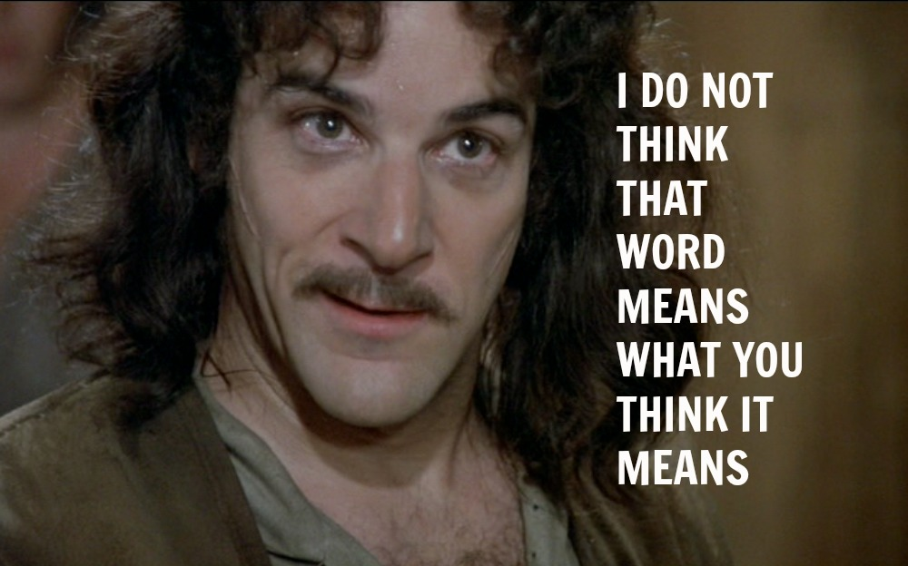
High Availability

Slide 22
High Availability & Disaster Recovery in Azure
High Availability
Availability within a single Azure region or datacenter*
Expectation is little or no downtime (99.x % uptime)
Disaster Recovery
Recover into a secondary datacenter if outage in primary datacenter
Acceptable downtime has a greater range
Quantified by Recovery Time Objective & Recovery Point Objective
Notes:
Different folks may have their own definitions for “high availability” and “disaster recovery”.
Let’s take some time to review what these terms mean specifically in Azure.
ANIMATE!!!
ANIMATE!!!
Availability is typically the amount of time a service is available (or “up”) within the context of a single datacenter or region.
ANIMATE!!!
Most Azure services are backed with an SLA that is quantified by 99 point some number of 9s % availability per month.
In general, when we say a service is “highly available” in Azure, the expectation is that there is little or no downtime.
For that service within the datacenter
ANIMATE!!!
ANIMATE!!!
With Disaster recovery, we are talking about the ability to recover your application into a secondary datacenter.
In the event of a datacenter outage.
(usually somewhere far away – at least 500 miles)
ANIMATE!!!
When this happens, the amount of acceptable downtime may have a greater range… from seconds,
to minutes, hours, or even a day!
It all depends on what type of Disaster Recovery plan you have in place.
The costs vary widely
Ranging from active deployments in 2 datacenters to just having backups in a secondary datacenter that you must recovery from.
ANIMATE!!!!
Choosing a disaster recovery plan depends on what the business requirements are for RTO & RPO.
RTO – Acceptable time to recover.
RPO – Acceptable amount of data that can be lost
Okay… so let’s start to apply this to the database…

Slide 23
Defining Disaster Recovery within Azure
Disaster recovery is being able to recover your application into another Azure datacenter
Keywords:
RTO: Recovery Time Objective
RPO: Recovery Point Objective
Options range from:
Complete active/active deployment in multiple datacenters
Active/Passive deployment in multiple datacenters
Active deployment in one datacenter, with backups stored in 2nd datacenter

Slide 24
Understanding Azure VM Availability Single VM
Azure SLA guarantees no data loss, 99.9% uptime SLA*
Subject to un-planned maintenance events due to physical failures
If VM becomes unavailable, Azure migrates VM and restarts in another host
~10-15 minutes to complete this process

Slide 25
Understanding Azure VM Availability Single VM
Azure SLA guarantees no data loss, 99.9% uptime SLA*
Subject to un-planned maintenance events due to physical failures
If VM becomes unavailable, Azure migrates VM and restarts in another host
~10-15 minutes to complete this process
Subject to planned maintenance events due to host OS servicing
All VMs on host are shut down.
Host OS is serviced and rebooted
All VMs on host are restarted
~10-15 minutes to complete this process
Subject to in-memory planned maintenance events
All VMs on host are paused, Host patched, VMs un-paused. 30 seconds downtime

Slide 26
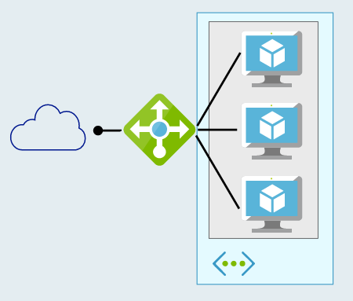
Defining High Availability 2 or more Azure VMs
Multiple VMs can be configured in an “availability set”
Workload is load balanced across the VMs
Azure SLA: 2 (or more) VMs in Availability Set:
99.95% (<22 min downtime p/month)
Includes
Planned downtime due to host OS servicing
Unplanned downtime due to physical failures
Doesn’t include servicing of guest OS or software inside (e.g. SQL)

Slide 27
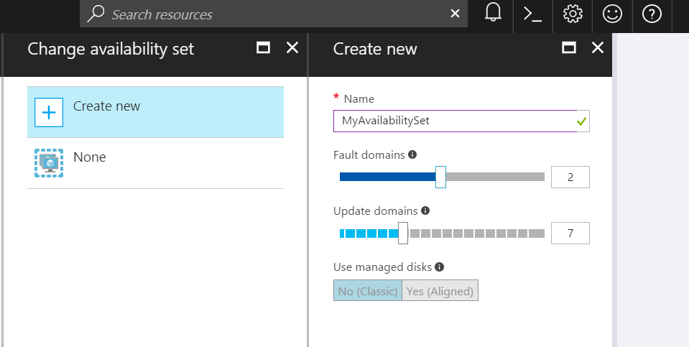
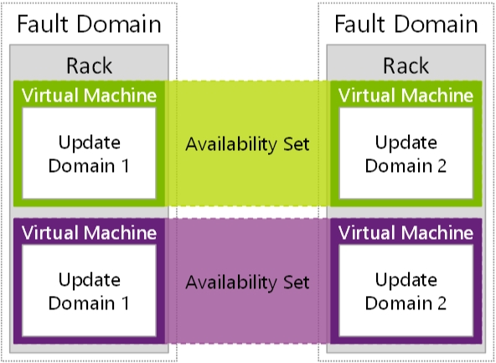
Availability Sets
Availability Sets are for Unplanned & Planned Maintenance
Fault Domains (2 default, some regions allow 3)
Upgrade Domains (5 default, 1-20 allowed)
Front with Load Balancer, App Gateway
Notes:
To provide redundancy to your application, we recommend that you group two or more virtual machines in an availability set.
Fault domain – collection of resources that may fail at the same time due to same root cause. Servers in same rack are part of same fault domain. A fault domain has a single point of failure. Place resources in separate fault domain so that they remain available in case of a failure
Update domain – logical collection of resources that can be updated at the same time. One update domain has updates applied at a time and may require rebooting. Pleace resources in separate update domains – it is automatic (indicate groups of virtual machines and underlying physical hardware that can be rebooted at the same time. )
One update domain has updates applied at a time
Availability set – can place vm’s in an availability set at creation or after deployment . Moving a vm in or out of availability set causes it to reboot
Fault domains
A fault domain is a logical group of underlying hardware that share a common power source and network switch, similar to a rack within an on-premises datacenter. As you create VMs within an availability set, the Azure platform automatically distributes your VMs across these fault domains. This approach limits the impact of potential physical hardware failures, network outages, or power interruptions.+
Update domains
An update domain is a logical group of underlying hardware that can undergo maintenance or be rebooted at the same time. As you create VMs within an availability set, the Azure platform automatically distributes your VMs across these update domains. This approach ensures that at least one instance of your application always remains running as the Azure platform undergoes periodic maintenance. The order of update domains being rebooted may not proceed sequentially during planned maintenance, but only one update domain is rebooted at a time.+
Managed Disk fault domains
For VMs using Azure Managed Disks, VMs are aligned with managed disk fault domains when using a managed availability set. This alignment ensures that all the managed disks attached to a VM are within the same managed disk fault domain. Only VMs with managed disks can be created in a managed availability set. The number of managed disk fault domains varies by region - either two or three managed disk fault domains per region. You can read more about these managed disk fault domains for Linux VMs or Windows VMs.
https://docs.microsoft.com/en-us/azure/virtual-machines/windows/manage-availability

Slide 28
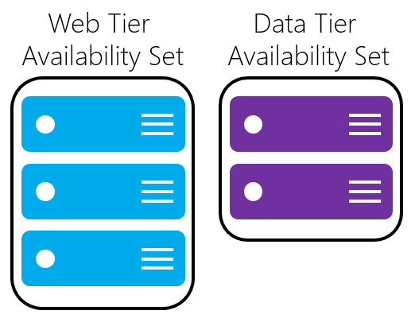
Availability Sets
Do NOT put a single VM in an Availability Set
Example - for an application,
Place front-end virtual machines in the same availability set
AND
Data-tier virtual machines in their own availability set
Notes:
Fault domain – collection of resources that may fail at the same time due to same root cause. Servers in same rack are part of same fault domain. A fault domain has a single point of failure. Place resources in separate fault domain so that they remain available in case of a failure
Update domain – logical collection of resources that can be updated at the same time. One update domain has updates applied at a time and may require rebooting. Place resources in separate update domains – it is automatic
One update domain has updates applied at a time
Availability set – can place vm’s in an availability set at creation or after deployment . Moving a vm in or out of availability set causes it to reboot

Slide 29
Availability Sets: How Do We Do It? Fault and Update Domains
Fault Domains
Represent groups of resources anticipated to fail together
i.e. Same rack, same server
Fabric spreads instances across fault at least 2 fault domains when two or more virtual machines are placed in an availability set
Update Domains
Represents groups of resources that will be updated together
Host OS updates honor service update domains
Specified in service definition
Default of 5 (up to 20)
Azure spreads role instances across Update Domains and Fault Domains

Slide 30
Virtual Machine Availability Sets Update Domains are honored by host OS updates
Fault Domain
Fault Domain
Rack
Rack
Availability Set
Virtual Machine
Virtual Machine
IIS1
IIS2
UD #1
UD #2
Availability Set
Virtual Machine
Virtual Machine
SQL1
SQL2
UD #1
UD #2

Slide 31
VM Scale Sets
High performance provisioning of 1000+ VMs
Auto-configuration at scale
Auto-scale based on schedule and resource metrics
Easy updates at scale
Simple Portal Integration
Notes:
So, VMs are great… but managing a lot of them individually can be hard. That’s where VM scale sets comes in..
The goal here is to enable management of like VMs as a group and make it easy to scale them in/out based on demand.

Slide 32
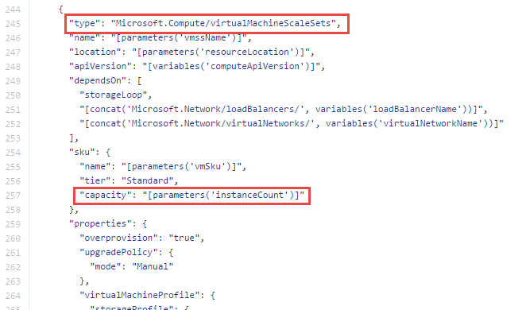
Why VM Scale Sets?
Manually scale with ‘capacity’ property
Autoscale with host metrics (MDM pipeline) or diagnostic extensions​
Small buy-in: Deploy/manage sets of 0->100 identically configured VMs ​
Guest OS patching: Patching primitives allow manually triggered rolling upgrades​​
High-availability – implicit availability set with 5 FDs/5 UDs​
Availability Sets vs Scale Sets
Avail Set: Multiple different VMs (image, size, etc); managed separately
Scale Set: Large count of the same VMs; managed together
Scale set: Reliable rapid provisioning and scale utilizing similarity of the VMs

Slide 33
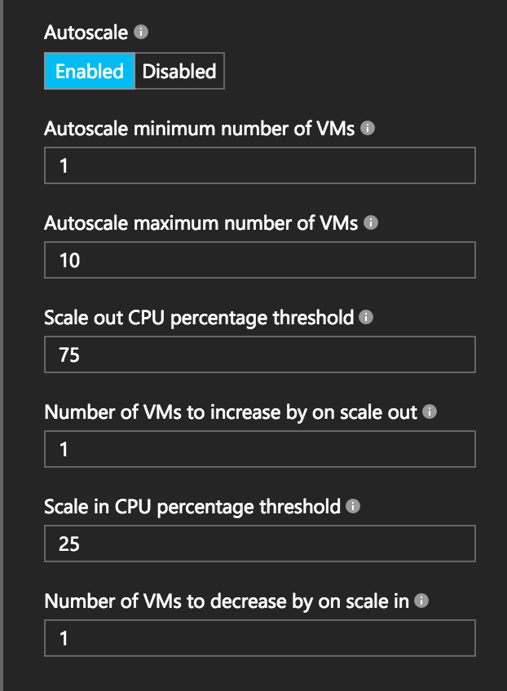
Autoscale with VM Scale Sets
Define Max – Min VMs
Define trigger and action rules
Standard audit / email notifications
Define webhooks for custom notifications and actions (e.g. runbooks)
Notes:
Metrics emitted by Azure Diagnostic Extension
Triggers can be basic performance metrics, and also schedule based, queue length based.

Slide 34
VM scale set app deployment models
Model | When to use
Marketplace | Off the shelf solutions.
VM Extensions | Full control over app lifecycle management.
Custom data/unattend | Install custom app independently of external network.
Configuration manager | Centrally managed app installation, credentials & maintenance.
Containerized | Abstract app management from infrastructure. Cloud/DC agnostic.
Custom image | Small self-contained apps. Fast deploy. Immutable build, test, deploy pipelines.
Notes:
There are many different ways to deploy software to VM scale sets. I won’t go into any great detail here, but just to give you a flavor…
If you’re simply looking to deploy an existing application off-the-shelf, you can use the Azure marketplace
Alternatively, you can use what we call a VM extension, which is a task triggered inside the VM after the base image has booted, where you can run arbitrary scripts.
You can also deploy a custom VM image that you’ve created with a tool like Packer

Slide 35




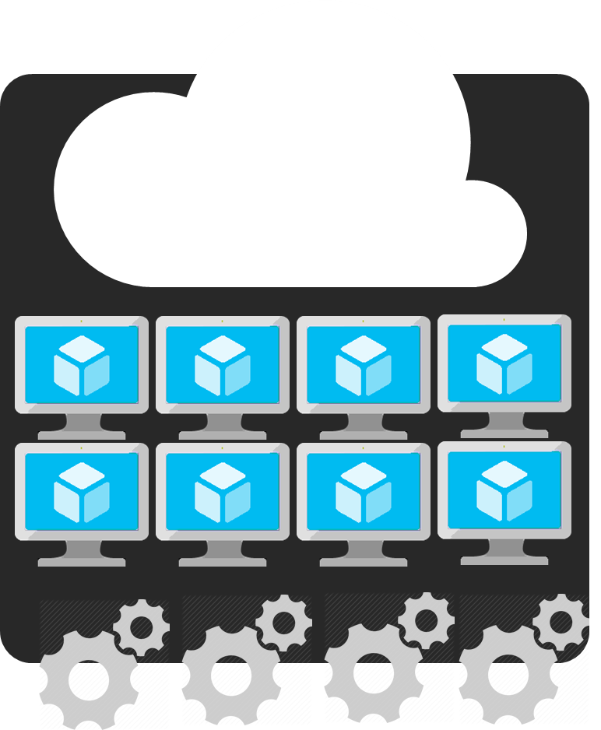
Azure Batch
APIM
Mobile apps
Logic apps
API apps
Notification hubs
Azure
functions
Compute pools for job processing
Automatic scaling and regional coverage
Linux and Windows
Automatically recover failed tasks
Input/Output handling
Low-Priority (discounted) option
Notes:
So with that little bit of context on VM scale sets, let’s start slowly moving up the stack…
While you can use VMSS directly, we expect most customers will interact with them through a higher-level abstraction.
One of those is Azure Batch, which enables highly-parallelizable job processing. You provide it with your job, configure the amount of compute you want to throw at it, and Batch will both schedule it efficiently and restart failed tasks as required.
Common scenarios include financial risk modeling, climate analysis, and media encoding

Slide 36
Design microservices-based solutions

Slide 37
Azure: The Power Of Choice
Application Hosting (today)
Virtual Machines
Containers
Customer-managed
(IaaS)
Notes:
Azure provides several cloud-based compute offerings to run your application so that you don't have to worry about the infrastructure details.
You can easily scale up or scale out your resources as your application usage grows. Azure offers services that cover the spectrum—from providing infrastructure-as-a-service (IaaS) to give you full control over your application hosting, through platform-as-a-service (PaaS) where the services are hosted for you, to true serverless hosting where all you need to do is write your code.

Slide 38
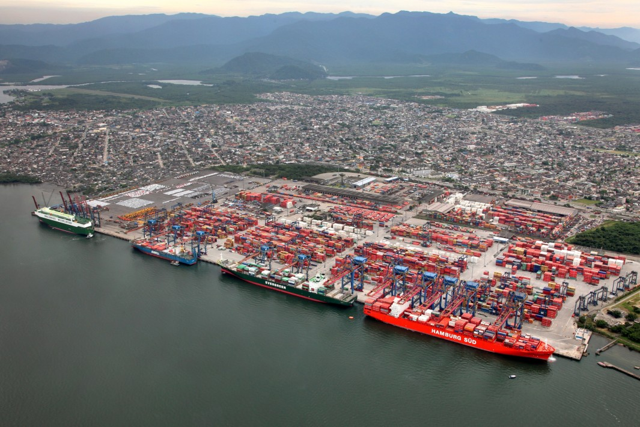
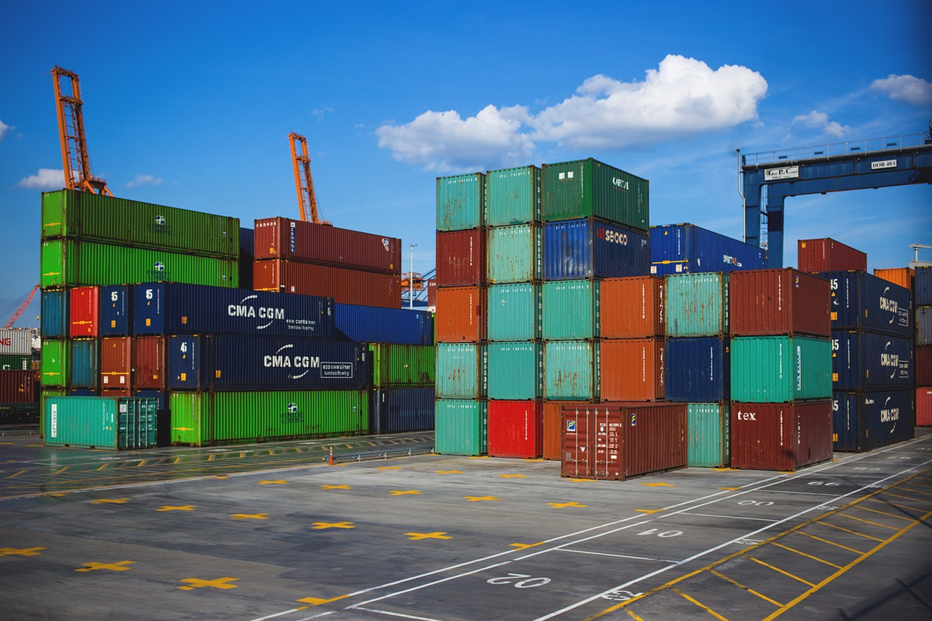
What is a Container?

Slide 39
What is a Container?
VM
VM
VM
VM
App A
App B
App C
Guest OS
Guest OS
Guest OS
Guest OS
Hypervisor
Hypervisor
Host OS
Host OS
Server
Server
Notes:
VM
Hypervisor => VMWare, HyperV
Can do turtles, all the way down till your machine feels like it’s running from a potato

Slide 40
What is a Container?
VM
VM
VM
VM
App A
App B
App C
Guest OS
Guest OS
Guest OS
Container Engine
Guest OS
Hypervisor
Hypervisor
Host OS
Host OS
Server
Server
Notes:
VM
Hypervisor => VMWare, HyperV
Can do turtles, all the way down till your machine feels like it’s running from a potato

Slide 41
What is a Container?
VM
VM
VM
VM
App A
App B
App C
Container
App A
Guest OS
Guest OS
Guest OS
Bins/Libs
Container Engine
Guest OS
Hypervisor
Hypervisor
Host OS
Host OS
Server
Server
Notes:
VM
Hypervisor => VMWare, HyperV
Can do turtles, all the way down till your machine feels like it’s running from a potato

Slide 42
What is a Container?
VM
VM
VM
VM
App A
App A
App B
Container
Container
Container
App A
App B
App C
Guest OS
Guest OS
Guest OS
Bins/Libs
Bins/Libs
Bins/Libs
Container Engine
Guest OS
Hypervisor
Hypervisor
Host OS
Host OS
Server
Server
Notes:
VM
Hypervisor => VMWare, HyperV
Can do turtles, all the way down till your machine feels like it’s running from a potato

Slide 43
Why?
Notes:
What benefits do you get from containers?

Slide 44
Lightweight
Notes:
From the diagram, you saw there’s less baggage.
- not spinning up new kernel for each app

Slide 45
Portable
Notes:
Guaranteed to run consistently, no matter where you depoy
Complete Isolation

Slide 46
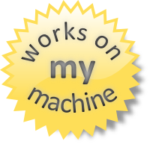
Notes:
Write Once, run anywhere

Slide 47
Ok, I’ve got containers.
Now what?

Slide 48
What is a Container Orchestrator?

Slide 49
What is a Container Orchestrator?
Container Orchestrator
VM
VM
Container
Container
Container
Container
Container
Container
App A
App B
App C
App A
App B
App C
Bins/Libs
Bins/Libs
Bins/Libs
Bins/Libs
Bins/Libs
Bins/Libs
Container Engine
Container Engine
Guest OS
Guest OS
Hypervisor
Hypervisor
Host OS
Host OS
Server
Server
Notes:
VM
Hypervisor => VMWare, HyperV
Can do turtles, all the way down till your machine feels like it’s running from a potato

Slide 50
What is a Container Orchestrator?
VM
VM
VM
Container Orchestrator
Container
Container
Container
Container
Container
Container
App A
App B
App C
App A
App B
App C
Bins/Libs
Bins/Libs
Bins/Libs
Bins/Libs
Bins/Libs
Bins/Libs
Container Engine
Container Engine
Guest OS
Guest OS
Guest OS
Hypervisor
Hypervisor
Hypervisor
Host OS
Host OS
Host OS
Server
Server
Server
Notes:
VM
Hypervisor => VMWare, HyperV
Can do turtles, all the way down till your machine feels like it’s running from a potato

Slide 51
What is the point of all of this?!

Slide 52
DevOps + Containers Enable Microservices

Slide 53
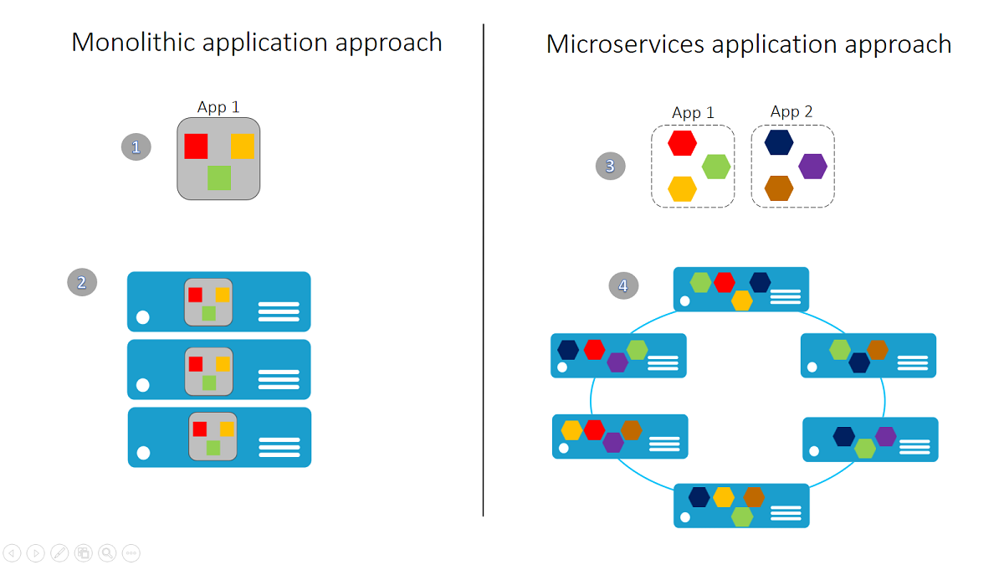
Microservices 101
Notes:
A monolithic app contains domain-specific functionality and is normally divided by functional layers, such as web, business, and data.
You scale a monolithic app by cloning it on multiple servers/virtual machines/containers.
A microservice application separates functionality into separate smaller services.
The microservices approach scales out by deploying each service independently, creating instances of these services across servers/virtual machines/containers.
What is a microservice?
There are different definitions of microservices. If you search the Internet, you'll find many useful resources that provide their own viewpoints and definitions. However, most of the following characteristics of microservices are widely agreed upon:+
Encapsulate a customer or business scenario. What is the problem you are solving?
Developed by a small engineering team.
Written in any programming language and use any framework.
Consist of code and (optionally) state, both of which are independently versioned, deployed, and scaled.
Interact with other microservices over well-defined interfaces and protocols.
Have unique names (URLs) used to resolve their location.
Remain consistent and available in the presence of failures.
+
You can summarize these characteristics into:+
Microservice applications are composed of small, independently versioned, and scalable customer-focused services that communicate with each other over standard protocols with well-defined interfaces.+
We covered the first two points in the preceding section, and now we expand on and clarify the others.

Slide 54
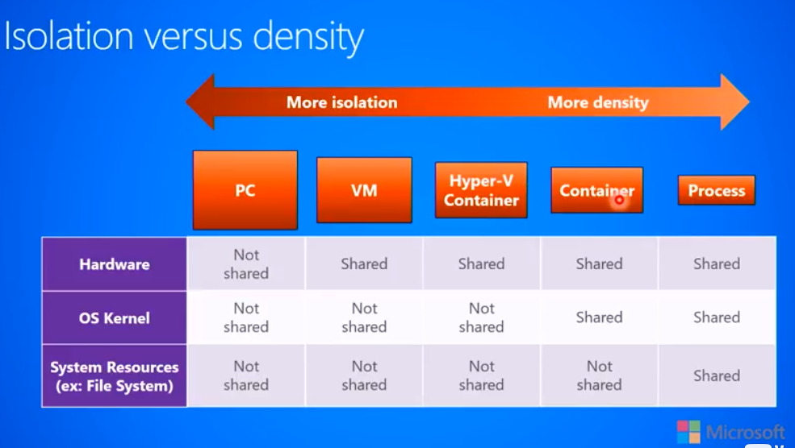
Microsoft: DEVOPS200.9x Architecting Distributed Cloud Applications

Slide 55
DevOps & Monolithic vs Micro Services
Micro Services
Split Services into small pieces
Easily Scale, Deploy, code, etc.
Faster Execution
Higher Reliability
Faster MTTR mean time to repair
Agile capabilities
Automation Continuous Delivery
Amplify Feedback Loops
Monolithic
All Feature in Full App
Long Cycles (Dev, Test, Q/A, Deploy, update, etc.)
Error / Bug Prone
Expensive
Quick Fixes hard or impossible
More bottlenecks
Harder to test (more changes at once)
Application
Feature A
Feature C
Feature E
Feature B
Feature D

Slide 56
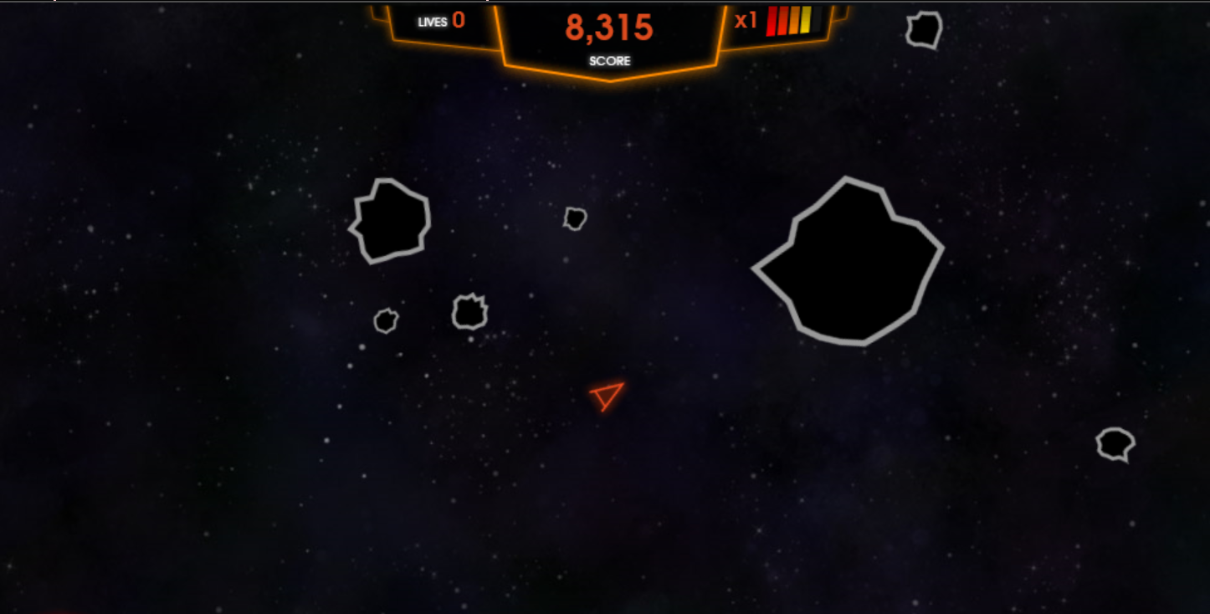
Monolith/Traditional vs Microservices/born in cloud
Asteroids

Slide 57
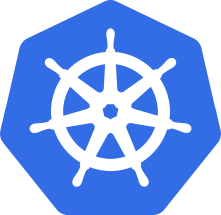
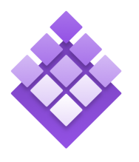

Azure Container Service
Azure Container Service
Making containers in Azure EZ!
Standard Docker tooling & API Support
Streamlined provisioning of K8S, DCOS, and Docker Swarm
Linux & Windows Server Containers
Azure & Azure Stack
ACS --> AKS (Preview)
Focus on Kubernetes
Managed Orchestrator
Kubernetes
DC/OS
Swarm
Notes:
Running alongside excitement in containers has been excitement about container orchestrators.
The core job of the orchestrator is to take your containers and deploy them within a pool of compute infrastructure, then monitor their health and resource usage as they run, restarting or load balancing them as required.
Two popular OSS orchestrators are DC/OS and Swarm. DC/OS is developed by Mesosphere and is based on the Apache Mesos scheduler, whereas Swarm is built by Docker Inc.
So what is the role of ACS relative to the orchestrators? Well, historically they’ve been a pretty big pain to set up since each has a set of specific dependencies and expects a particular topology, including the deployment of a master node alongside a set of workers. ACS provides an easy way to configure an Azure environment that covers all of that and creates an environment that incorporates a number of best practices.
One important thing to note here is that EVERYTHING is OSS. You could easily take apps running on ACS and move them to another environment without changing anything you do.

Slide 58

Azure Container Instances (Preview)
Simplest and easiest way to run individual containers in the cloud
No VM management
Per-second billing with customized resource requests
Linux and Windows Server containers
Notes:
Running alongside excitement in containers has been excitement about container orchestrators.
The core job of the orchestrator is to take your containers and deploy them within a pool of compute infrastructure, then monitor their health and resource usage as they run, restarting or load balancing them as required.
Two popular OSS orchestrators are DC/OS and Swarm. DC/OS is developed by Mesosphere and is based on the Apache Mesos scheduler, whereas Swarm is built by Docker Inc.
So what is the role of ACS relative to the orchestrators? Well, historically they’ve been a pretty big pain to set up since each has a set of specific dependencies and expects a particular topology, including the deployment of a master node alongside a set of workers. ACS provides an easy way to configure an Azure environment that covers all of that and creates an environment that incorporates a number of best practices.
One important thing to note here is that EVERYTHING is OSS. You could easily take apps running on ACS and move them to another environment without changing anything you do.

Slide 59
Azure: The Power Of Choice
Application Hosting (today)
Virtual Machines
Containers
Service Fabric
Customer-managed
(IaaS)
Platform-managed
(mIaaS/PaaS)
Notes:
Azure provides several cloud-based compute offerings to run your application so that you don't have to worry about the infrastructure details.
You can easily scale up or scale out your resources as your application usage grows. Azure offers services that cover the spectrum—from providing infrastructure-as-a-service (IaaS) to give you full control over your application hosting, through platform-as-a-service (PaaS) where the services are hosted for you, to true serverless hosting where all you need to do is write your code.

Slide 60
Microsoft Azure Service Fabric A platform for reliable, hyperscale, microservice-based applications
Microservices
Service Fabric
Container Orchestration & lifecycle management
Application Programming Models
High Availability
Hybrid Operations
Data Partitioning
Health Monitoring
Self-healing
Simple programming models
High Density
Rolling Upgrades
Low Latency
Placement Constraints
Fast startup & shutdown
Replication & Failover
Hyper-Scale
Automated Rollback
Stateful services
Load balancing
Management
Communication
Reliability
Hosting
Subsystem
Testability
Windows
Server
Linux
Windows
Server
Linux
Azure
Hosted Clouds
Federation
Windows
Server
Linux
Private Clouds
Transport
Notes:
Service Fabric enables you to build and manage scalable and reliable applications composed of microservices running at very high density on a shared pool of machines (commonly referred to as a Service Fabric cluster).
Powers a huge set of Microsoft Services: Azure SQL Database, Azure DocumentDB, Cortana, Power BI, Microsoft Intune, Azure Event Hubs, Skype for Business and others
It provides a sophisticated runtime for building distributed, scalable stateless and stateful microservices.
Also provides comprehensive application management capabilities for provisioning, deploying, monitoring, upgrading/patching, and deleting deployed applications.
Service Fabric is tailored to creating “born in the cloud” services that can start small, as needed, and grow to massive scale with hundreds or thousands of machines, creating Service Fabric clusters across availability sets in a region or across regions.

Slide 61
Architectural capabilities of BC/DR
You need all three
Primary site
Primary site
Secondary site
Original
Backup
DATA
DATA
High availability
Disaster recovery
Backup
When your applications have a catastrophic failure, run a second instance
When your applications have a catastrophic failure, run them in Azure or a secondary datacenter
When your data is corrupted, deleted or lost you can restore it
Notes:
Now let’s make sure we are using the same terminology for the various parts of a business continuity strategy.
HA is
DR is
Backup is
I’m going to focus on Backup and DR.

Slide 62
RPO “Recover Point Objective” & RTO “Recover Time Objective are time intervals, typically expressed in number of hours
RPO is the maximum targeted time that data can be lost (in time)—it is the amount of time between backup, replication, or synchronization. It answers the question, “What is an acceptable amount of data loss?” It is usually much smaller than RTO.
RTO is how long it takes (in time) to restore services after a disaster. It answers the question, “How long will it take to get service back up?”

Slide 63
An asynchronous operation is one that transpires sequentially: first one action, and then another. The operations do not take place simultaneously. This type of processing means that there is a time gap between the first operation and the second. An example would be writing data to primary and secondary storage. First data is written to the primary; data destined for the secondary is queued and must wait until the write operation to the primary is complete.

Slide 64
Synchronous means that operations are carried out at the same time (think of this as parallel processing). With this type of processing, there is no time gap between the first process and the second process. Both operations take place simultaneously.

Slide 65
Architectural capabilities of BC/DR
Recovery Point Objective (RPO) and Recovery Time Objective (RTO)
Drivers of solution cost
Minimal data loss
Reduce downtime
Availability: Storage redundancy & SLAs
Blob storage: (LRS, GRS, RA-GRS), SLAs
Synchronous vs asynchronous (how data is written)
SQL Server Always On Availability Groups (replication for availability)
Network connectivity
Application connectivity post failover
IP management
Load balancers
Notes:
RPO is the amount of data that can be lost (in time)—it is the amount of time between backup, replication, or synchronization. It answers the question, “What is an acceptable amount of data loss?” It is usually much smaller than RTO.
RTO is how long it takes to restore services after a disaster. It answers the question, “How long will it take to get service back up?”

Slide 66
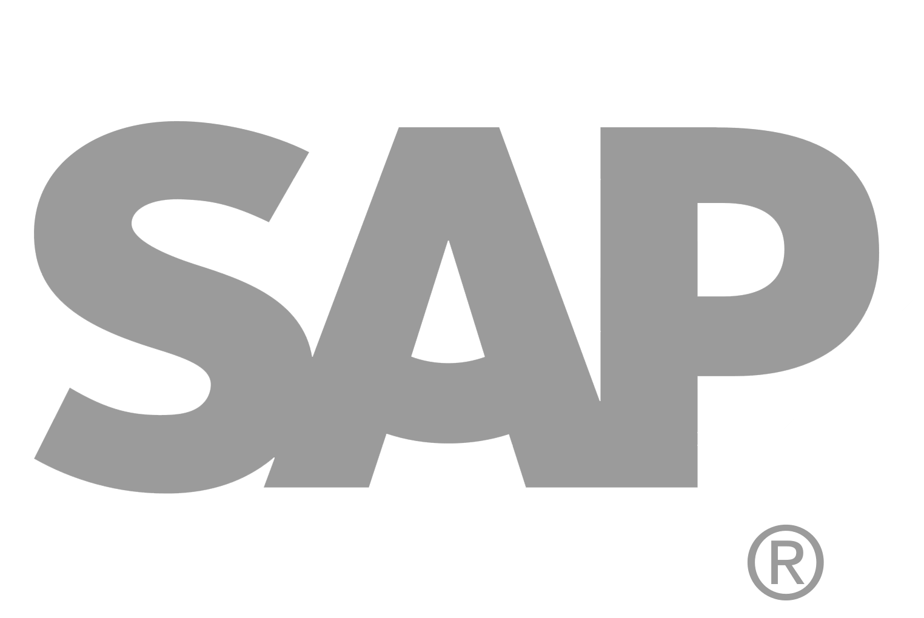
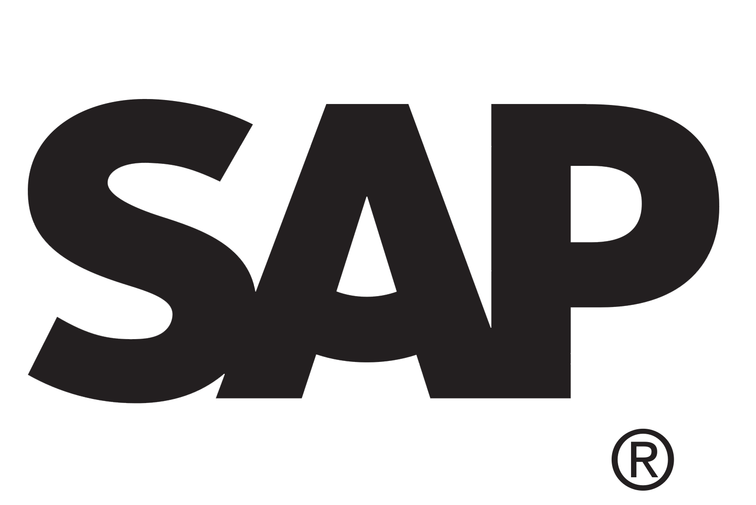
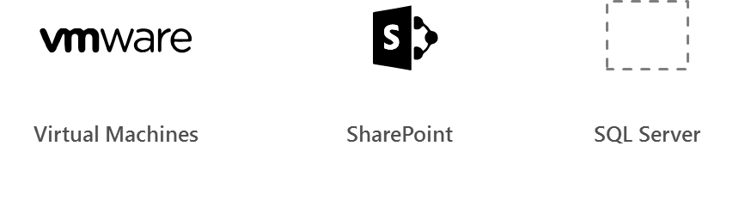
Azure Site Recovery
Azure
Automated, seamless disaster recovery from the cloud to protect applications
Provides application-consistent recovery of critical workloads
Leverage current investments
Orchestrate one-click recovery even for complex multi-tier applications
WHEN NOT
Workload requires synchronous replication, data outside of VHD
Exchange
SAP
Production Environment
SharePoint
App n
Automated
Policy-based
Orchestrated
Encrypted
VPN
ExpressRoute
Downtime
Exchange
SAP
SharePoint
App n
Production Environment
Hyper-V
Bare metal
On-premises/cloud Datacenter

Slide 67
Azure Site Recovery support matrix *
Source | Target | Availability | Supported Guest OS Types
Hyper-V 2012 R2 | Azure | Available | All Guest OS types supported by Azure
Hyper-V 2008 R2 SP1 and 2012 | Azure | Available | Windows* and Linux*
VMware vSphere 5.1, 5.5, 6.0 and Physical Servers | Azure | Available | Windows* and Linux*
Amazon Web Services (Windows AMIs) | Azure | Available | Windows Server 2008 R2 SP1+ (HVM only)
Amazon Web Services (Linux AMIs) | Azure | Available | RHEL 6.7 HVM
Hyper-V 2012 | Hyper-V 2012R2 | Available | All Guest OS types supported by Hyper-V
VMware vSphere 5.1, 5.5, 6.0 | Hyper-V 2012R2 | Available via Microsoft Services Global Delivery | Windows Server 2008 R2 SP1+
* May be asked on the exam what ASR will support for a certain scenario
Source: https://docs.microsoft.com/en-us/azure/site-recovery/
Notes:
Notes:
*Limited to Windows Server 2008 R2 SP1+, Red Hat 6.7, 7.1, 7.2, CentOS 6.5, 6.6, 6.7, 7.0+ Oracle Enterprise Linux 6.4, 6.5, SUSE Linux Enterprise Server 11 SP3
*Documentation: https://docs.microsoft.com/en-us/azure/site-recovery/
Azure VM between Azure Region is in Preview now

Slide 68
Azure BC/DR Capabilities & Use Cases
Hyper-V Replica
Simple, Affordable Second Site
“Extended Replication” + 3rd Party Integration
Hardware Agnostic – either side
Hybrid Cloud
Seamless Integration:
Private Cloud or on-premises to…
Service Provider Cloud
Microsoft Azure
Azure Site Recovery (ASR)
WHEN TO USE: 2nd Site / Use SCCM,SCVMM, Unprotected workloads
WHEN NOT TO USE:
Workload requires synchronous replication, data outside of VHD
Workload needs to recover physical servers, beyond Hyper-V replica’s capabilities

Slide 69
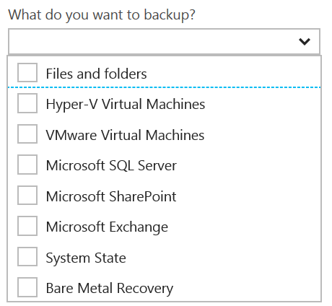
Disaster Recovery Capabilities & Use Cases
Azure Backup
Reliable, Simple, Efficient backup and restore (agent based)
Use for Branch Office or Small Business
Backup and restore files and folders
No Central Management
Azure Backup Server
Disk (D2D), giving high RTOs for tier 1 workloads
Azure (D2D2C) for long term retention
Modern Backup Storage technology (MABS v2)
VMware capabilities
Application Consistency (SQL, Exchange, SharePoint)
No Tape Backup
No Integration with System Center
Requires Azure Subscription
System Center Data Protection Manager (DPM)
Physical, VM, Azure VM
Store Locally to Disks (D2D) and to Tape (D2T)
Store in Azure (D2D2C) for long term retention
Full application consistency across server apps (Exch, SP, SQL…)
Small backup window
Bare Metal Recovery / Recovery to Azure
Full System Center Integration (discovery, reporting, etc)
StorSimple
Proprietary Device | Multiple Tiers
Cloud Integrated Storage (CiS)
Seamless view of ALL Enterprise Storage
Windows and VMWare
Multi-Tiers backup and recovery (Hot/Cold)
Fastest Solution
Long Term Azure storage; scale storage out to Azure
minimize on-premesis disk requirements
Seamless view of ALL Enterprise Storage | Windows and VMWare

Slide 70
Additional Information: SLA for Site Recovery 99.9%
"Failover" is the process of transferring control, either simulated or actual, of a Protected Instance from a primary site to a secondary site.
"On-Premises-to-Azure Failover" is the Failover of a Protected Instance from a non-Azure primary site to an Azure secondary site. Customer may designate a particular Azure datacenter as a secondary site, provided that if Failover to the designated datacenter is not possible, Microsoft may replicate to a different datacenter in the same region.
"On-Premises-to-On-Premises Failover" is the Failover of a Protected Instance from a non-Azure primary site to a non-Azure secondary site.
"Protected Instance" refers to a virtual or physical machine configured for replication by the Site Recovery Service from a primary site to a secondary site. Protected Instances are enumerated in the Protected Items tab in the Recovery Services section of the Management Portal.

Slide 71
Sharding is when you split a database and partition the different parts of the database across multiple drives. A shard is a single horizontal partition of the database.
Notes:
Large table
Just SQL Database table into small
A to D in one database
E to G in another DB
They should be pulled together
You can setup the large database per day basis or per week depending on it.
Existing application can’t be move to sharding. You will have re write the code into the application. Use different API. It is ane xtra work. For scaling point is it amazing. It is only for Relational Database. RDBMS

Slide 72
READ & Practice https://docs.microsoft.com/pdfstore/en-us/Azure.azure-documents/live/backup.pdf
Link from https://docs.microsoft.com/en-us/azure/backup/backup-try-azure-backup-in-10-mins – Download PDF

Slide 73
Azure Backup Key Workloads
Specialized Workloads
File/Folders/Volumes
Virtual Machines
Exchange
SharePoint
SQL Server
Windows Server
Windows
Windows
Linux
Hyper-V
Windows Server
Microsoft Azure
VMware
Notes:
1.
Workload: Files and folders
Source Machine: Windows Server or Windows Client
Azure Backup Solutions:
Azure Backup agent,
System Center DPM (+ the Azure Backup agent),
Azure Backup Server (includes the Azure Backup agent)
2.
Workload: Hyper-V virtual machine (Win & Linux), VMWare Virtual Machine (Win & Linux), Microsoft SQL Server, Microsoft SharePoint, Microsoft Exchange
Source Machine: Windows Server
Azure Backup Solution: System Center DPM (+ the Azure Backup agent); Azure Backup Server (includes the Azure Backup agent)
3.
Workload: Azure IaaS VMs (Windows) and Azure IaaS VMs (Linux)
Source Machine: N/A
Azure Backup Solution: Azure Backup (VM extension)

Slide 74
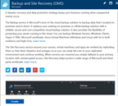
How It Works: Azure Backup Server
2. Register and configure Vault
1. Create Backup and Site Recovery Vault
3. Install Azure Backup Server software
4. Schedule & Back up encrypted data
Azure Backup Windows Server/Client
5. Recover to the same or a different server; On-Premisis or Azure VM
Step-By-Step
https://docs.microsoft.com/en-us/azure/backup/backup-try-azure-backup-in-10-mins
Notes:
Sign Up at the Azure portal
Install Azure Backup Server software
Register and configure
Back up encrypted data
Anytime the data leaves your boundary, it is encrypted. You have the passwords and keys and it’s always restored in Azure.
Recover to the same or a different server

Slide 75
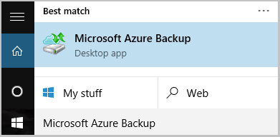
Name of the Backup agent Installer is:
MARSagentinstaller.exe
Backup Agent is
Microsoft Azure Backup
"C:\Program Files\Microsoft Azure Recovery Services Agent\bin\wabadmin.msc"
Maximum rate of backups per day?
Three (3) times per day!
Notes:
Maximum backup is 3 times per day – every 8 hours

Slide 76
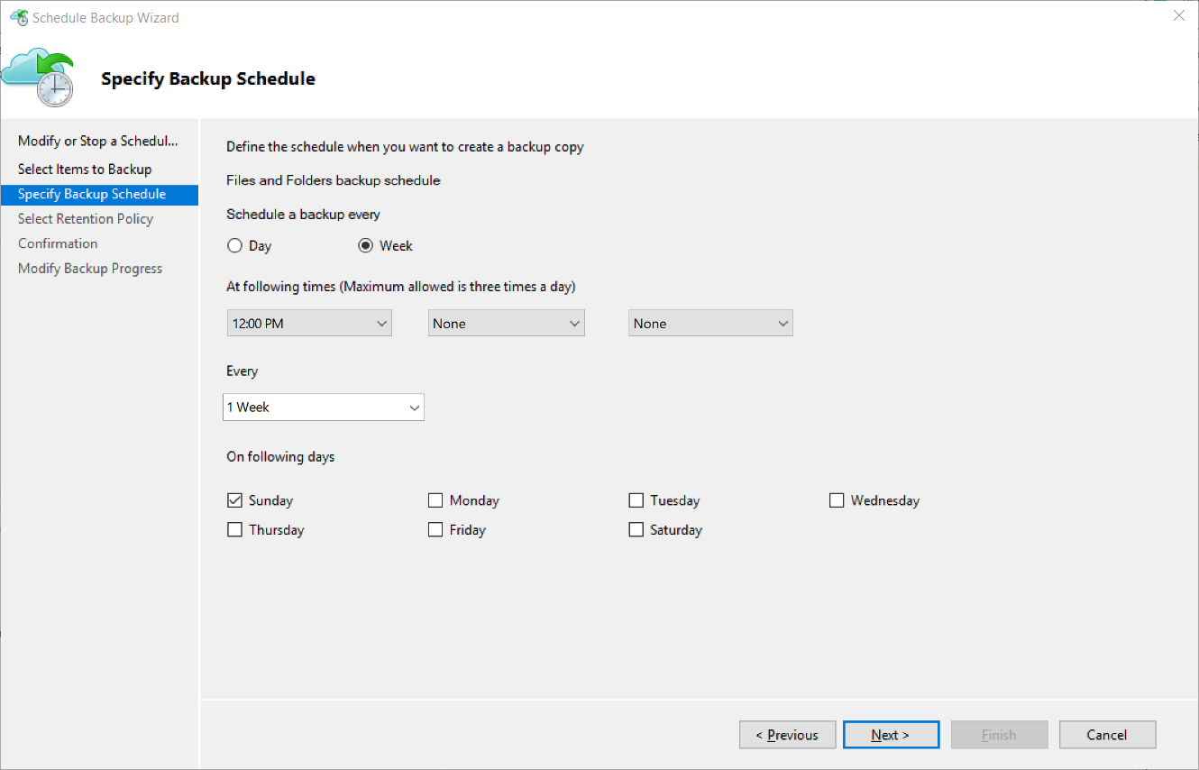
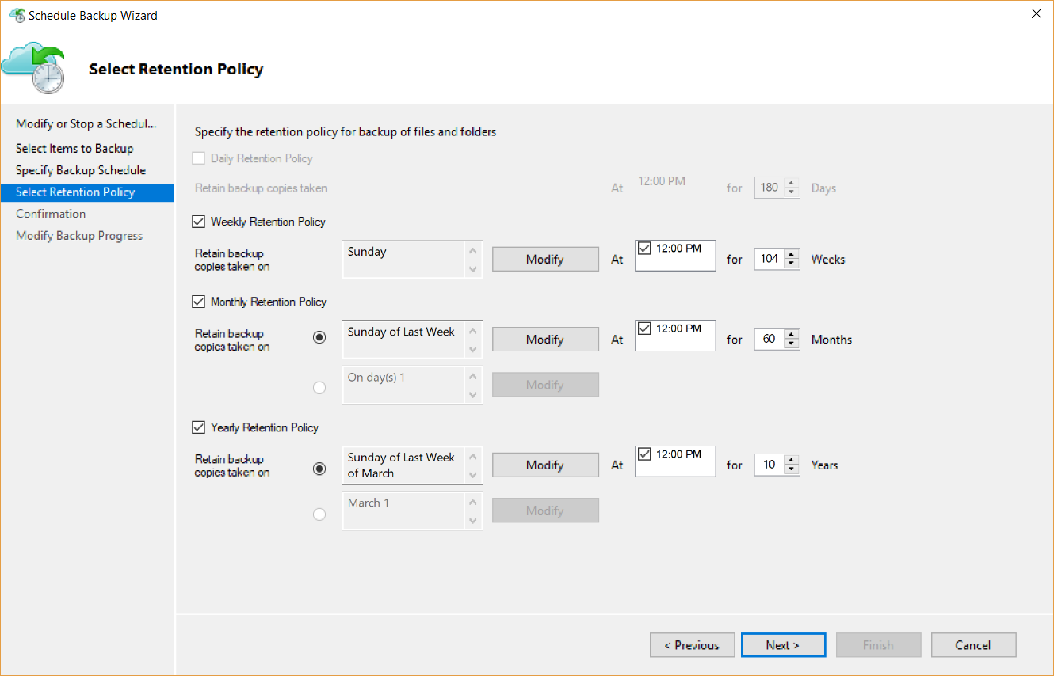
Backup Schedule & Retention Policy
Backup Schedule
Retention Policy

Slide 77
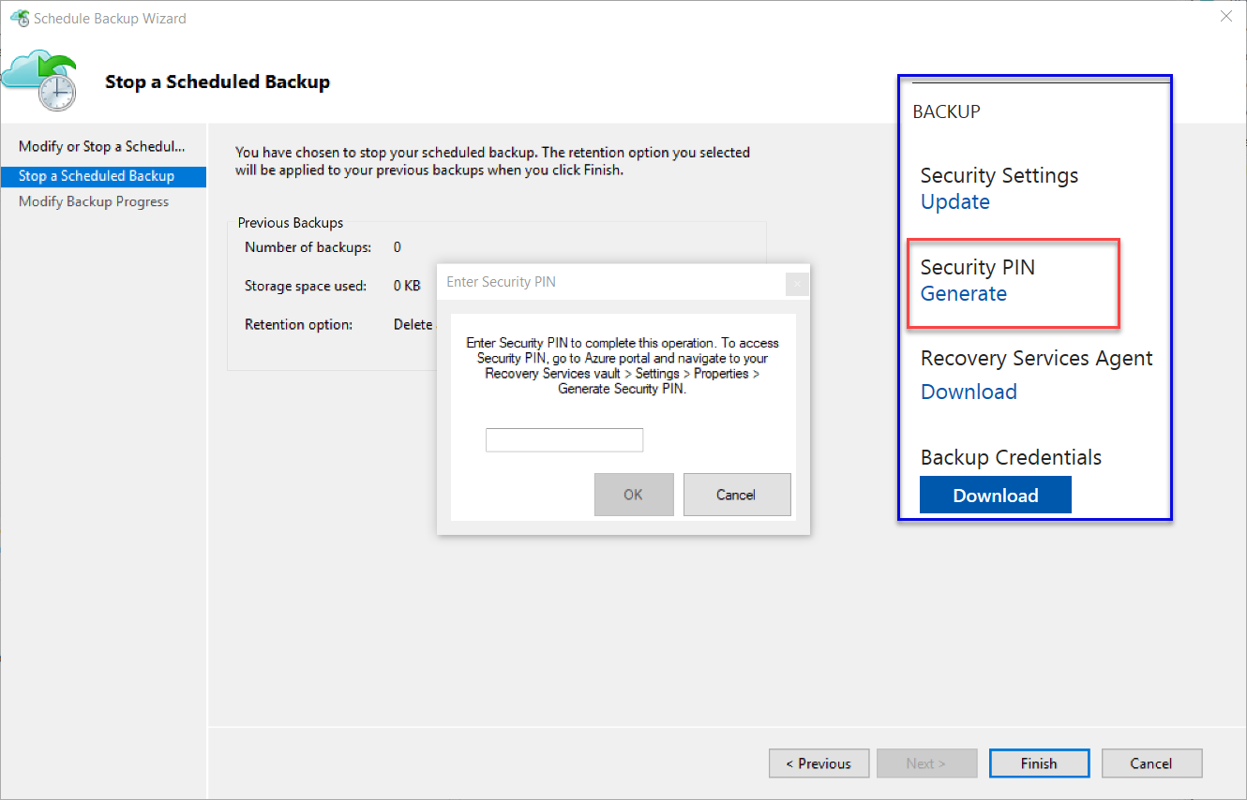
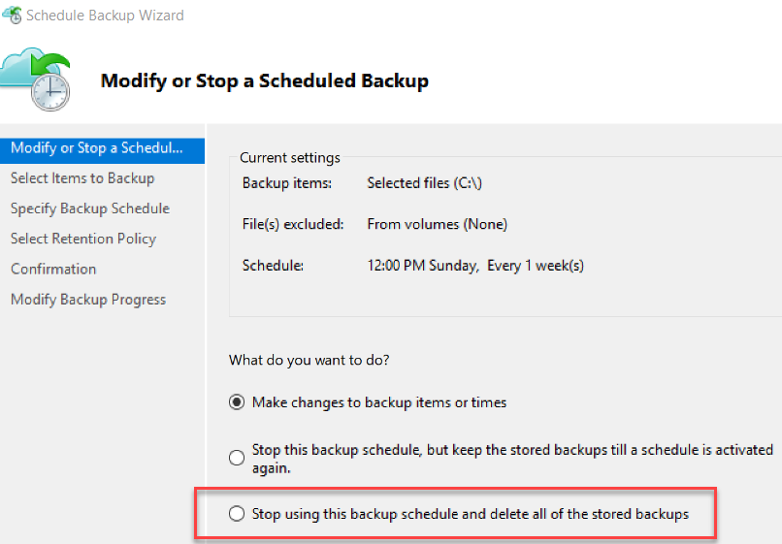
Cancelling Schedule and Removing Backups

Slide 78
Microsoft Azure Backup Server v2
Protect application workloads:
Hyper-V VMs, Microsoft SQL Server, SharePoint Server, Microsoft Exchange and Windows clients
Backup To:
Disk (D2D), giving high RTOs for tier 1 workloads
Azure (D2D2C) for long term retention
Modern Backup Storage technology (MABS v2) store backups:
Using Resilient File System (ReFS) block-cloning technology to store incremental backups,
MABS v2 significantly improves storage usage and performance.
Note: VMware is supported only in testing if Azure Backup Server is deployed on Windows 2016
Microsoft Azure Backup Server (MABS) Deployment:
physical standalone server.
Hyper-V virtual machine
Windows virtual machine in VMWare
Physical standalone server
Hyper-V virtual machine
Windows virtual machine in VMWare
An Azure virtual machine - back up cloud workloads running as Azure virtual machines.
Disks for backup storage pool: 1.5 times size of data to be protected
Docs: https://azure.microsoft.com/en-us/blog/announcing-microsoft-azure-backup-server/
Download: https://www.microsoft.com/en-us/download/details.aspx?id=55269

Slide 79
Documentation / More Info…
Azure Key Vault:
https://docs.microsoft.com/en-us/azure/key-vault/
Azure Backup:
https://docs.microsoft.com/en-us/azure/backup/

Slide 80
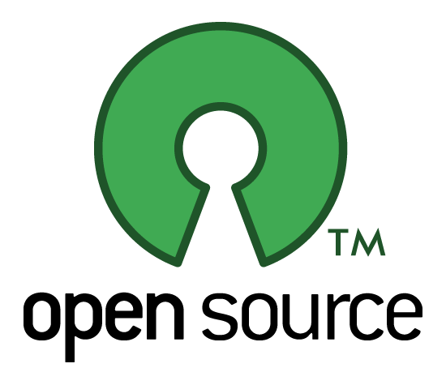
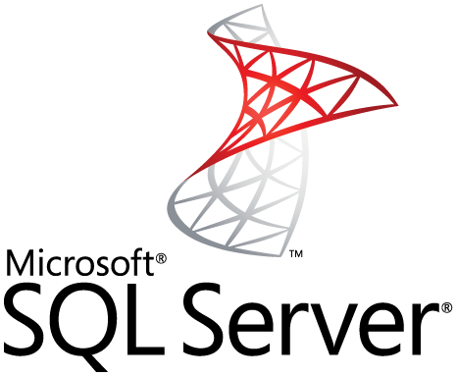
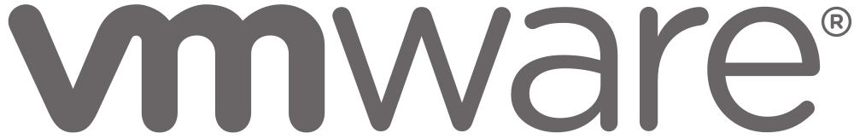
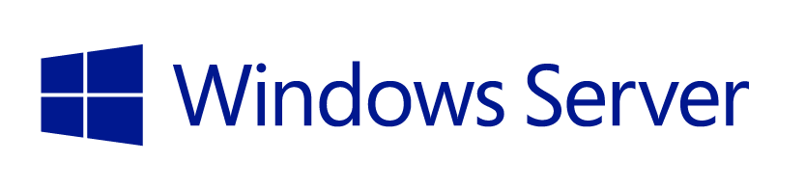
StorSimple Supported workloads
How customers benefit
Infrastructure on-demand workloads
DR
Search / Data mining
Dev / Test
Cloud apps
Capacity driven workloads
Traditional on-premises workloads
File shares
Collaboration
Archives
VM workloads
SharePoint
SQL Server
Notes:
This slide is shows the alignment of different workloads with different capabilities / configurations of StorSimple solution.
For large, unstructured, capacity driven data-sets, use tiered volumes for cloud storage
For performance driven workloads – use local volumes as a local storage.
For on-demand infra requirements like DR, and dev-test, use the StorSimple Cloud Appliance
So what does all these enhancements mean for partners?

Slide 81
EXAM TIP!
StorSimple uses iSCSI protocol to link data storage. This means that the storage that is in Azure is presented as locally attached iSCSI volumes.

